Slide 1
Alliteration
Figurative Language

Slide 2
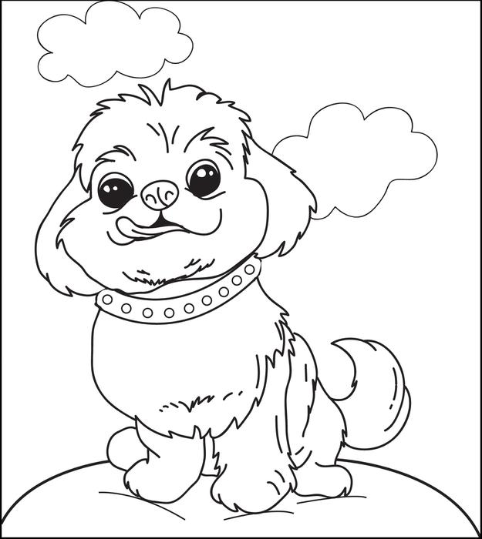
Vocab Square
Fluffy frolicked with her favorite friends at the farmyard festival on Friday
Alliteration: The repetition of the same consonant sound in words occurring near one another.
Review sounds!

Slide 3
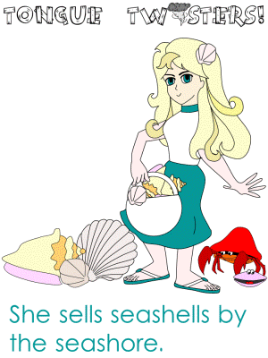
ALLITERATION
Alliteration is where the same sound is repeated at the beginning of each word in a sentence or phrase.
For example:
Terrible twos
Who forgot to fence in Fido?

Slide 4
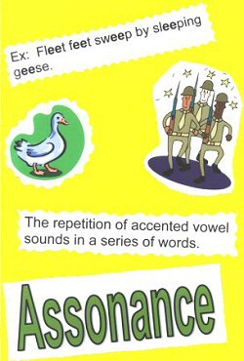
Assonance
Assonance is where a VOWEL sound is repeated ANYWHERE in a word.
For example:
The Spruce Goose
Happy camper

Slide 5
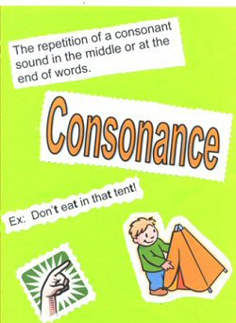
Consonance
Consonance is where a CONSONANT sound is repeated ANYWHERE in a word.
For example:
Pitter patter of little feet
Pick a peck of pickled peppers

Slide 6
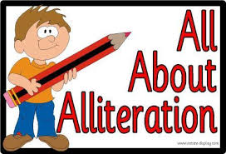
Non-Fiction
Can anyone think of a place where we use alliteration in non-fiction?
“Santorum Sweeps Deep South Primaries”

Slide 7
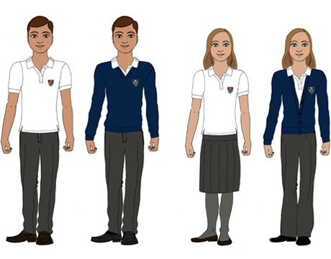
School Uniform Title
School boards are looking into requiring that every student should wear a uniform. What type of alliterative titles can we use to describe an article reporting on this?
Example: “School Uniforms: Awesome or Awful?”

Slide 8
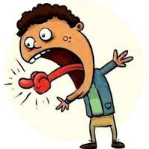
Make a tongue twister!
Find your 9 o’clock clock appointment partner and create a tongue twister!
Try to make it at least 3 sentences or 15-20 words! You have 5 minutes!

Slide 9
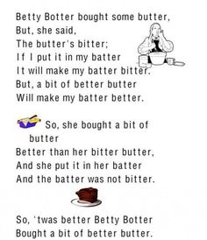
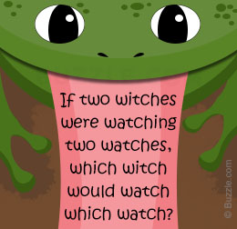
Examples

Slide 10
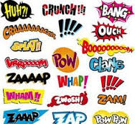
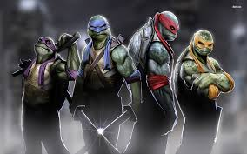
Onomatopoeia

Slide 11
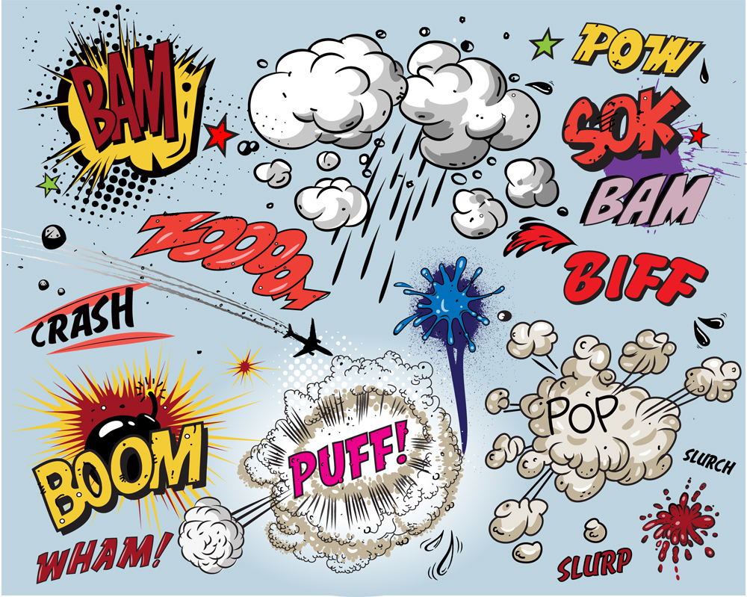
Vocab Square
Fluffy listened to the honks and screeches and other sounds of the city
Onomatopoeia: The use of a word that sounds like its meaning
https://www.youtube.com/watch?v=2Ks5-thZl4w

Slide 12
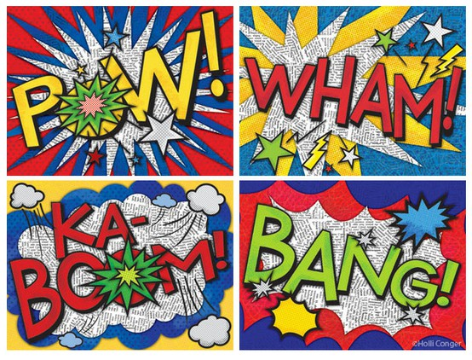
Exit Ticket – Create Poster!
You have the rest of the class period to create a poster for any onomatopoeia word you choose! Please work individually. Good luck!!

Slide 13
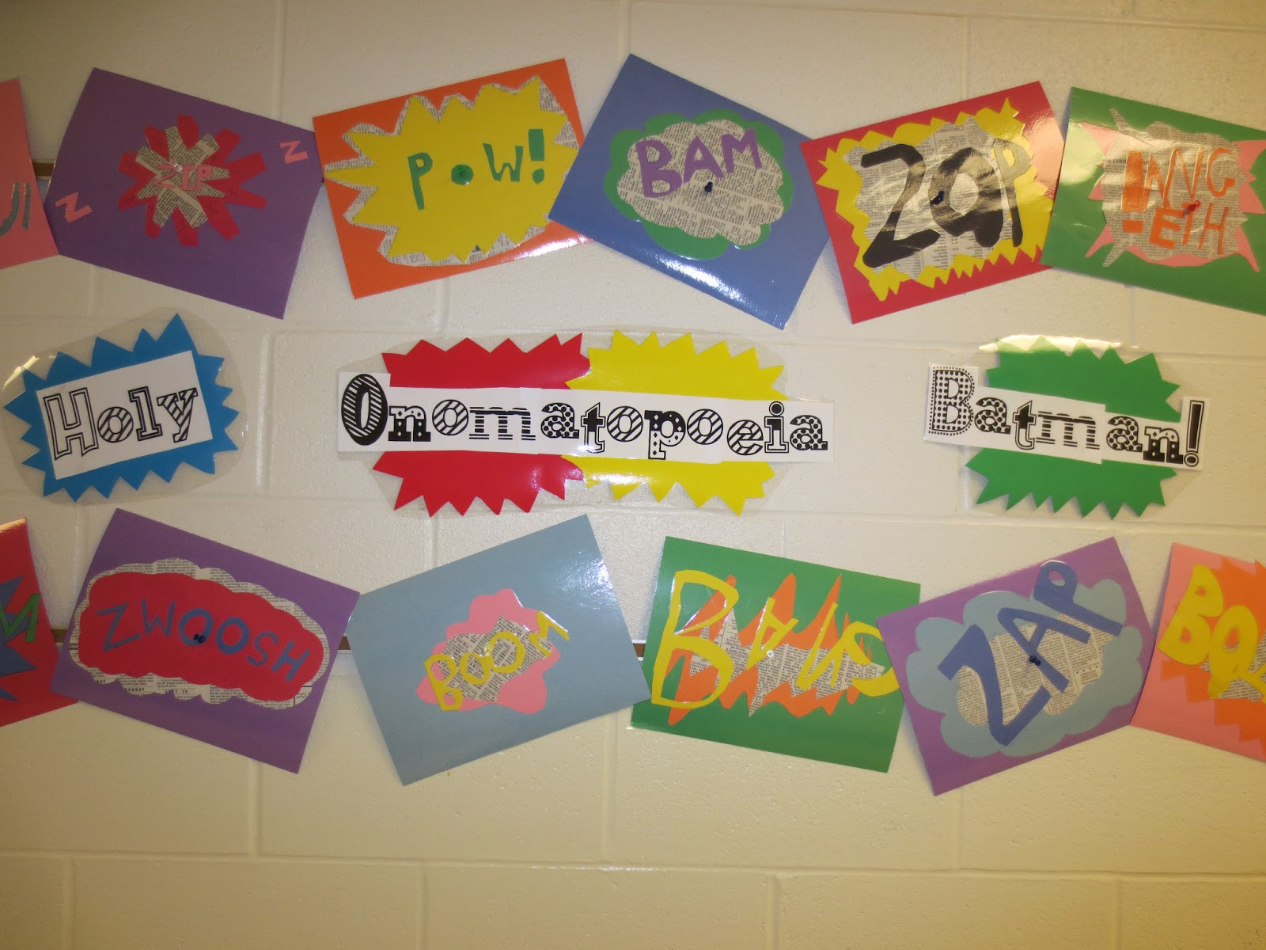
Example Artwork #1

Slide 14
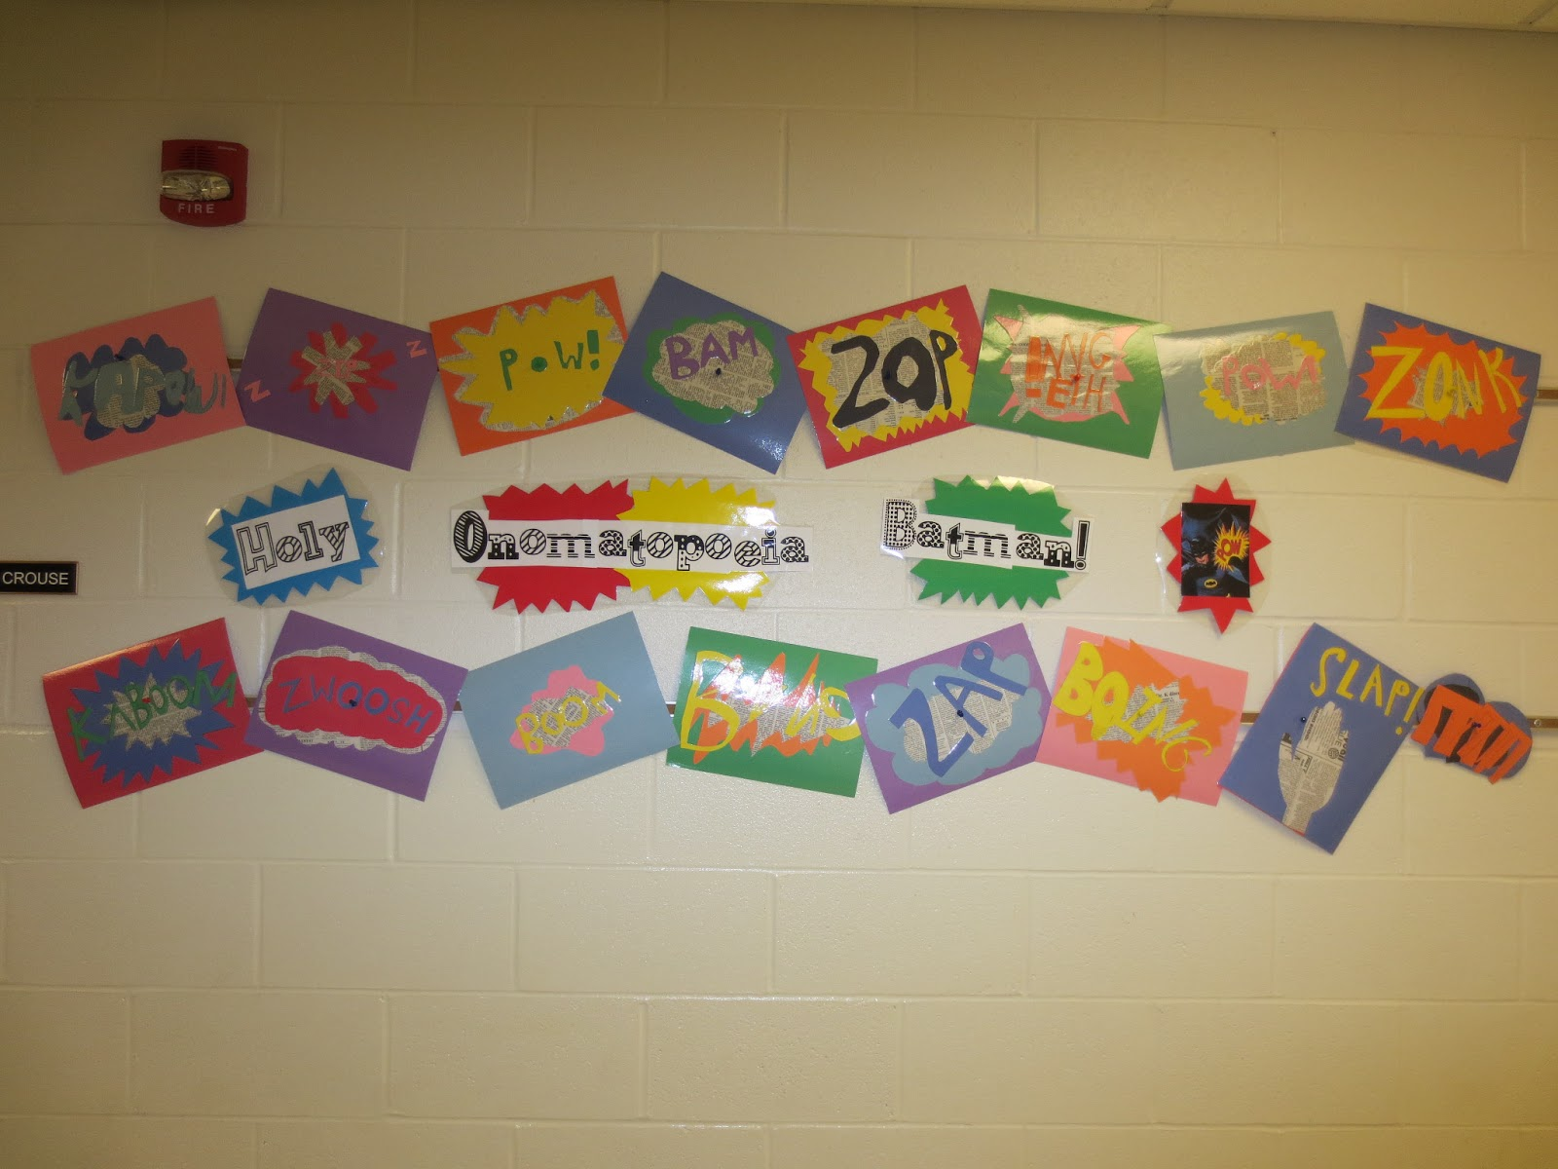
Example #2

Slide 15
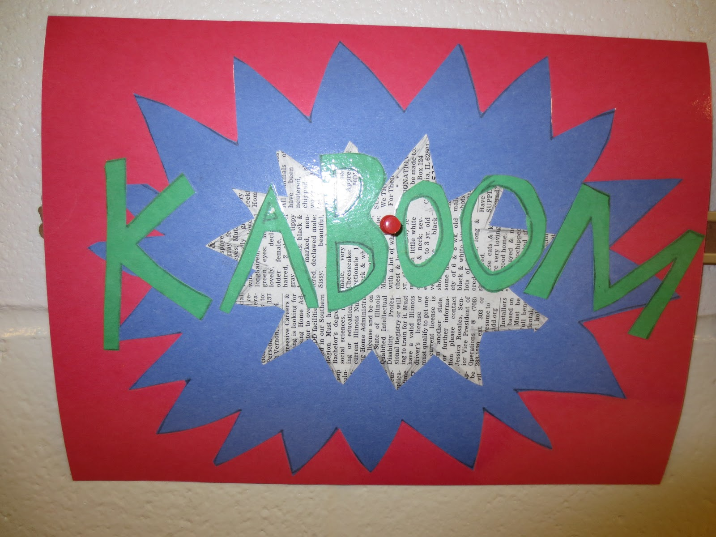
Example #3

